Slide 1
School Bus Transport Management
Review 2 · Database schema
PostgreSQL 15+
Notes:
Review 2 database schema for a school bus transport management system, written for PostgreSQL 15+.

Slide 2
Schema at a glance
12
11
12
6
Tables
Foreign keys
CHECK rules
Unique rules
fleet to payments
incl. 1 composite
values and ranges
5 constraints + 1 index
Covers the full school-transport workflow
Fleet and staff, routes and stops, student registration, fee plans, daily pickup logs, payments and bus maintenance. IDs are explicit so sample data is reproducible.
Notes:
The schema has 12 tables, 11 foreign key constraints, 12 CHECK constraints, 5 UNIQUE constraints and 1 partial unique index.

Slide 3
How the 12 tables connect
MaintenanceRecord
Bus
Stop
Student
PickupLog
Driver
Route
RouteSequence
TransportRegistration
Payment
Attendant
FeePlan
Fleet & staff
Routes & stops
Students & fees
Daily operations
Arrows run from the child table (holds the foreign key) to its parent.
Notes:
Route links a bus, a driver and an attendant. RouteSequence joins routes to stops. TransportRegistration is the hub that ties students, fee plans and route stops together, and PickupLog and Payment hang off it.

Slide 4
Fleet and maintenance
Bus
MaintenanceRecord
Column | Type | Rule
bus_id | INTEGER | PK
number | VARCHAR(20) | UNIQUE
capacity | INTEGER | CHECK 1 to 60
model | VARCHAR(80) | NOT NULL
status | VARCHAR(12) | ACTIVE / SERVICE
Column | Type | Rule
maint_id | INTEGER | PK
bus_id | INTEGER | FK → Bus
service_date | DATE | NOT NULL
description | VARCHAR(200) | NOT NULL
cost | NUMERIC(10,2) | CHECK ≥ 0
next_due | DATE | NOT NULL
One bus has many maintenance records. Capacity is capped at 60 seats and status is limited to ACTIVE or SERVICE.

Slide 5
Crew and route assignment
Driver
Route
Column | Type | Rule
driver_id | INTEGER | PK
name | VARCHAR(80) | NOT NULL
license_no | VARCHAR(15) | UNIQUE + format
phone | VARCHAR(15) | NOT NULL
Column | Type | Rule
route_id | INTEGER | PK
route_name | VARCHAR(100) | NOT NULL
bus_id | INTEGER | FK → Bus
driver_id | INTEGER | FK → Driver
attendant_id | INTEGER | FK → Attendant
shift | VARCHAR(10) | MORNING / AFTERNOON
Attendant
Column | Type | Rule
attendant_id | INTEGER | PK
name | VARCHAR(80) | NOT NULL
phone | VARCHAR(15) | NOT NULL
One route, one crew
One bus, driver and attendant per route, in a single shift.
Notes:
License numbers must match two letters followed by thirteen digits (15 characters in total).

Slide 6
Stops and route sequencing
Stop
RouteSequence
Column | Type | Rule
stop_id | INTEGER | PK
stop_name | VARCHAR(100) | NOT NULL
latitude | NUMERIC(9,6) | CHECK -90 to 90
longitude | NUMERIC(9,6) | CHECK -180 to 180
Column | Type | Rule
route_id | INTEGER | PK, FK → Route
stop_id | INTEGER | PK, FK → Stop
seq_no | INTEGER | CHECK > 0
scheduled_time | TIME | NOT NULL
Valid coordinates
Latitude stays within -90 to 90 and longitude within -180 to 180.
Ordered, no duplicates
A stop appears once per route, and each position number is used once per route (UNIQUE route_id, seq_no).

Slide 7
Students and fee plans
Student
FeePlan
Column | Type | Rule
student_id | INTEGER | PK
name | VARCHAR(80) | NOT NULL
class | VARCHAR(8) | NOT NULL
section | VARCHAR(4) | NOT NULL
guardian_name | VARCHAR(80) | NOT NULL
Column | Type | Rule
plan_id | INTEGER | PK
term | VARCHAR(20) | NOT NULL
amount | NUMERIC(10,2) | CHECK > 0
academic_year | VARCHAR(9) | NOT NULL
Who rides
Class, section and guardian are stored here; transport details live in registrations.
What it costs
A plan is defined by term, amount and academic year. Amounts must be above zero.

Slide 8
Transport registration
TransportRegistration
Valid stops only
The (route_id, stop_id) pair must exist in RouteSequence.
Column | Type | Rule
reg_id | INTEGER | PK
student_id | INTEGER | FK → Student
route_id | INTEGER | FK (route, stop)
stop_id | INTEGER | FK (route, stop)
plan_id | INTEGER | FK → FeePlan
start_date | DATE | NOT NULL
status | VARCHAR(10) | ACTIVE / INACTIVE
One active ride
A partial unique index allows one ACTIVE registration per student.
Linked to a fee plan
Every registration points to one plan and a start date.
CREATE UNIQUE INDEX
one_active_assignment_per_student
ON TransportRegistration(student_id)
WHERE status = 'ACTIVE';
Notes:
The composite foreign key on (route_id, stop_id) stops a student being registered at a stop that is not on the chosen route.

Slide 9
Daily pickups and payments
PickupLog
Payment
Column | Type | Rule
log_id | INTEGER | PK
reg_id | INTEGER | FK → Registration
trip_date | DATE | NOT NULL
event_type | VARCHAR(8) | PICKUP / DROP
event_time | TIME | NOT NULL
Column | Type | Rule
payment_id | INTEGER | PK
reg_id | INTEGER | FK → Registration
paid_on | DATE | NOT NULL
amount | NUMERIC(10,2) | CHECK > 0, ≤ 50,000
receipt_no | VARCHAR(30) | UNIQUE
One event per day
Each registration can log at most one PICKUP and one DROP per trip date.
Traceable receipts
Every payment carries a unique receipt number and is tied to a registration.

Slide 10
Integrity rules at a glance
Rule | Where | Effect
Seat limit | Bus.capacity | 1 to 60 seats
Status values | Bus, TransportRegistration | ACTIVE / SERVICE; ACTIVE / INACTIVE
License format | Driver.license_no | 2 letters + 13 digits, unique
Shift values | Route.shift | MORNING or AFTERNOON
Coordinate bounds | Stop | Latitude ±90, longitude ±180
Stop order | RouteSequence | seq_no > 0, unique per route
Money checks | FeePlan, Payment, MaintenanceRecord | Amount > 0; payment ≤ 50,000; cost ≥ 0
Daily event log | PickupLog | One PICKUP and one DROP per day
Single active ride | TransportRegistration | Partial unique index on student_id

Slide 11
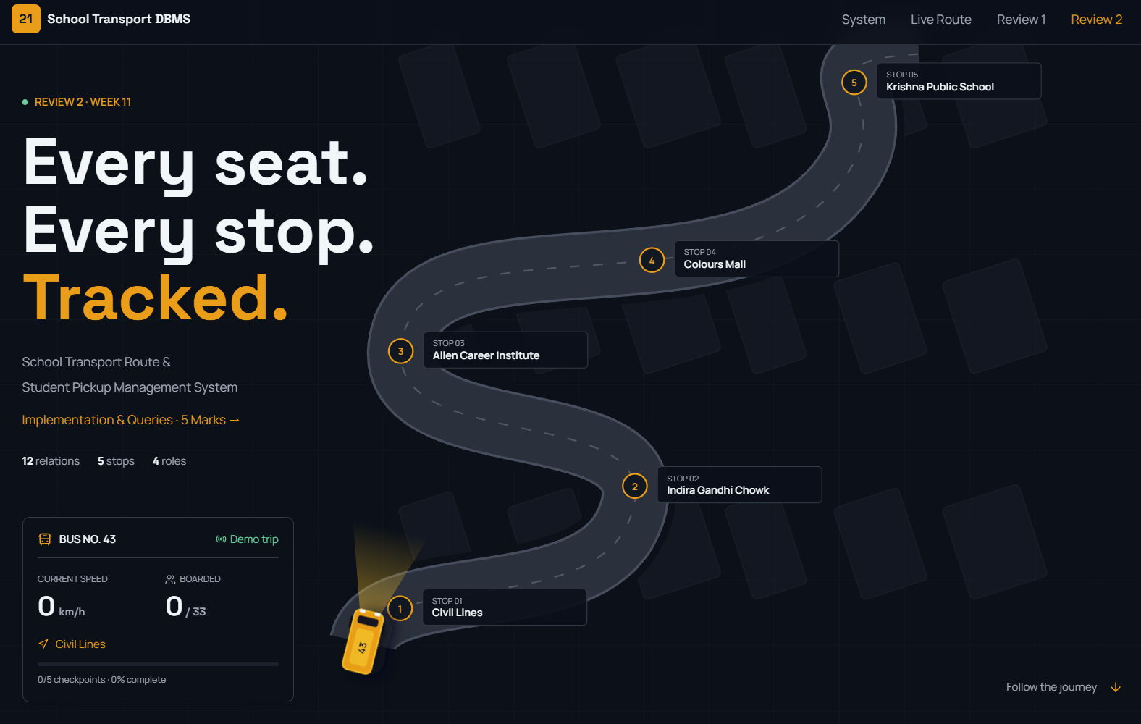
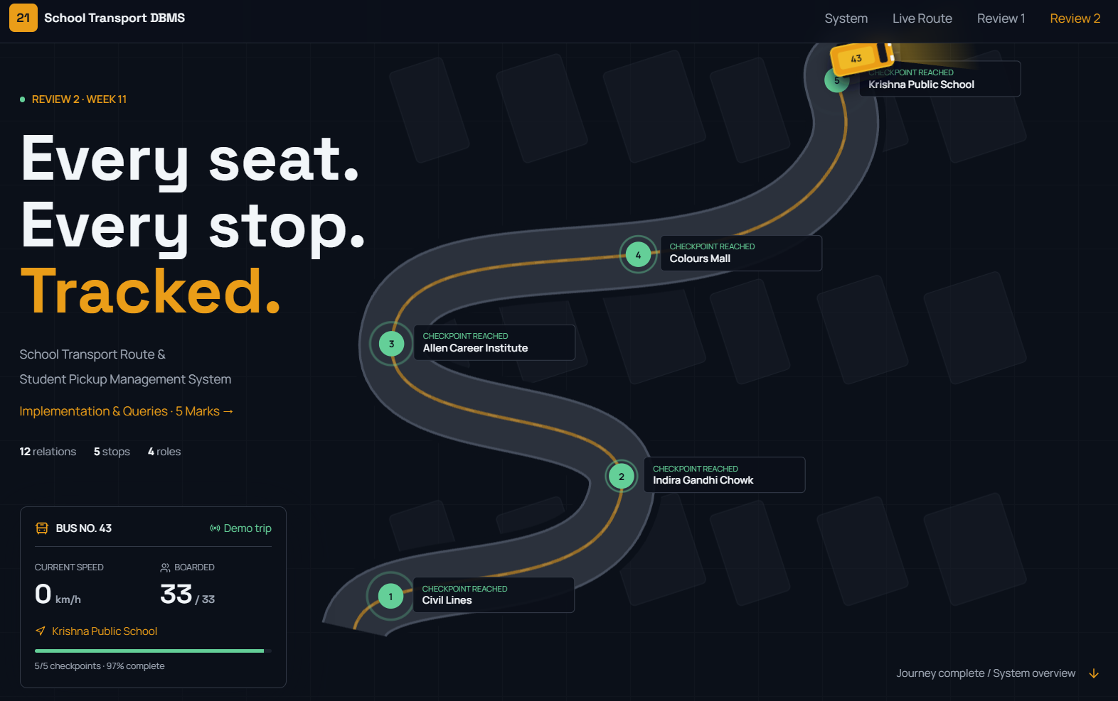
The live website: hero
Landing page: Bus No. 43 waiting at Civil Lines
Demo trip finished: 5/5 checkpoints, 33/33 boarded

Slide 12
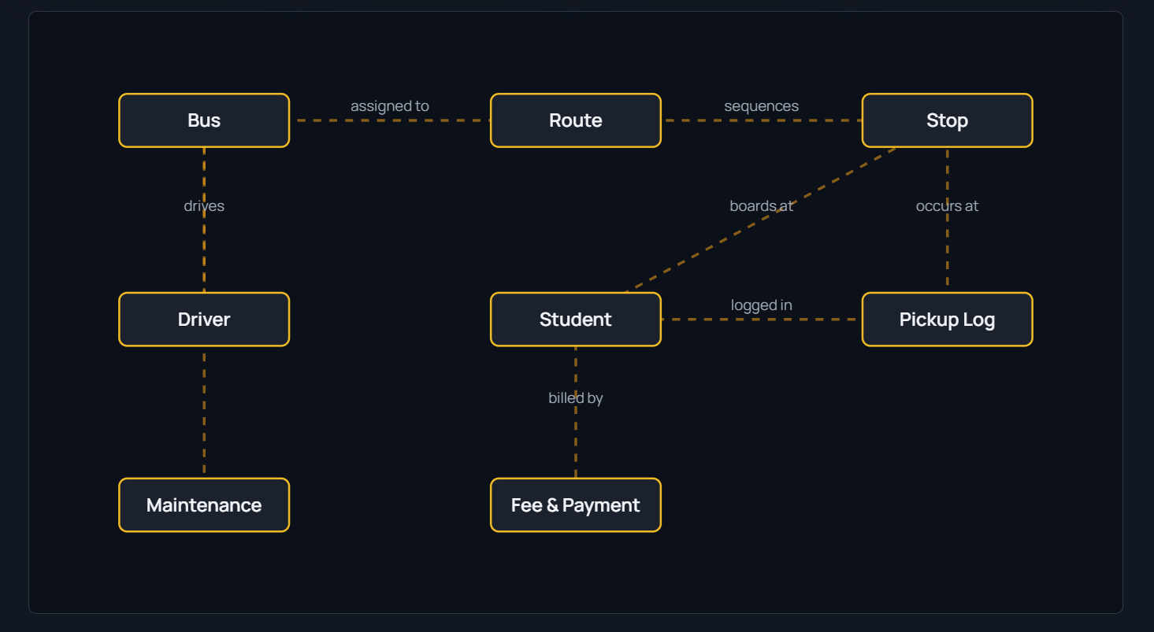
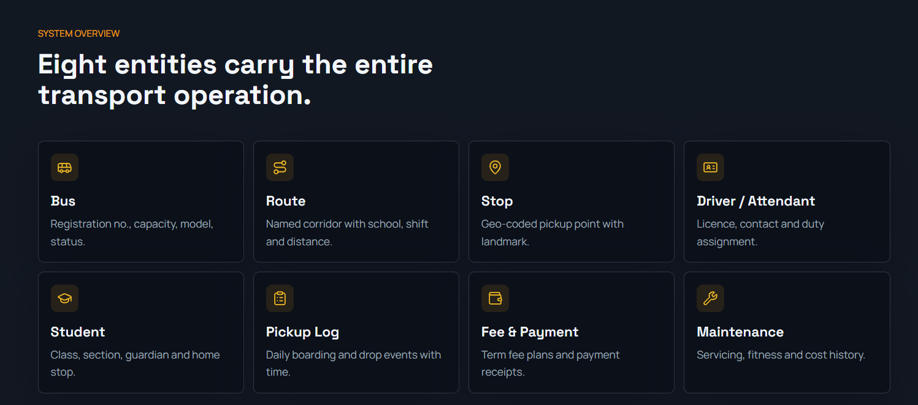
System overview
Eight entity groups carry the operation
Relationship map between the entities

Slide 13
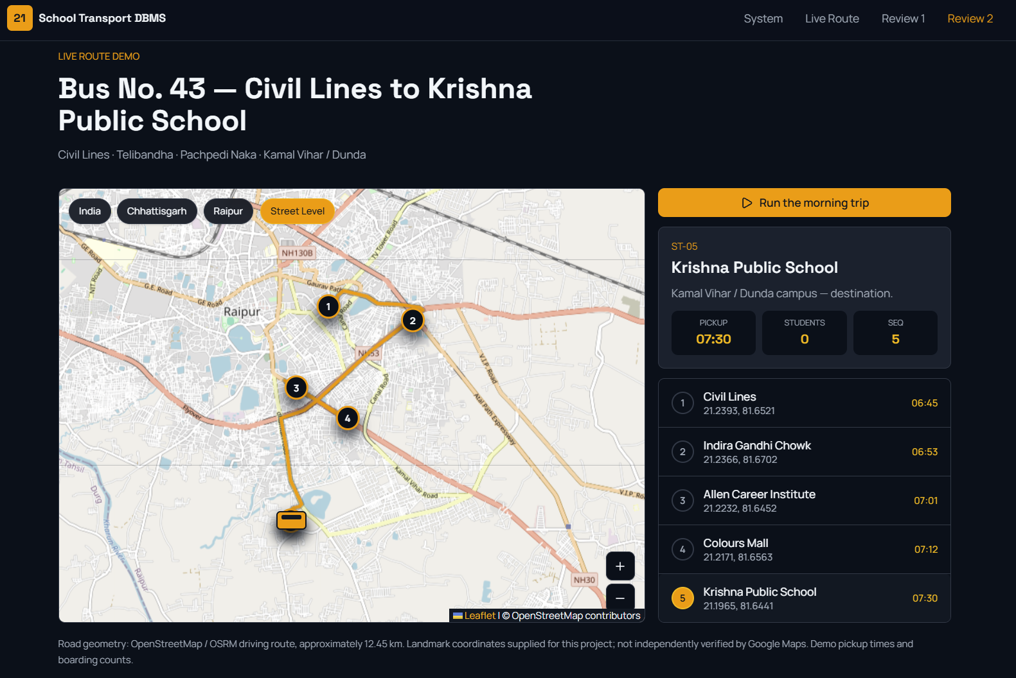
Live route demo
Bus No. 43 route on a Raipur street map with scheduled stop times

Slide 14
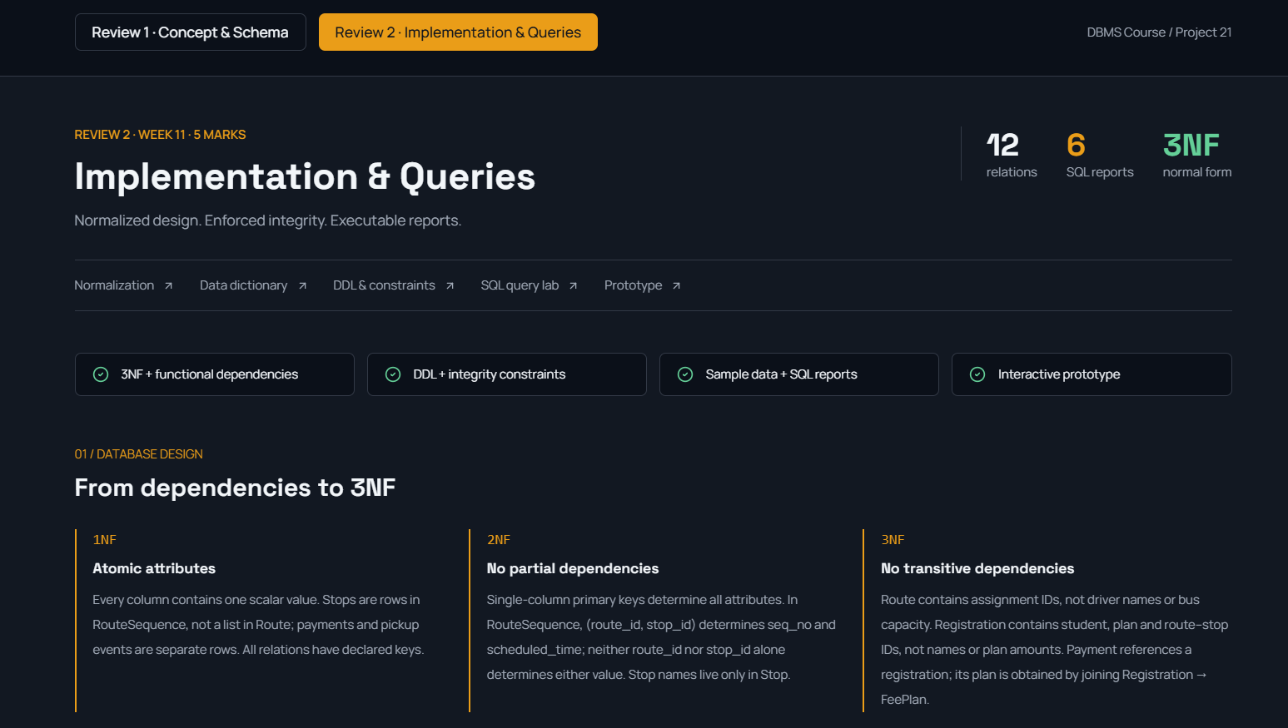
Review 2: implementation and queries
From dependencies to 3NF: 12 relations, 6 SQL reports

Slide 15
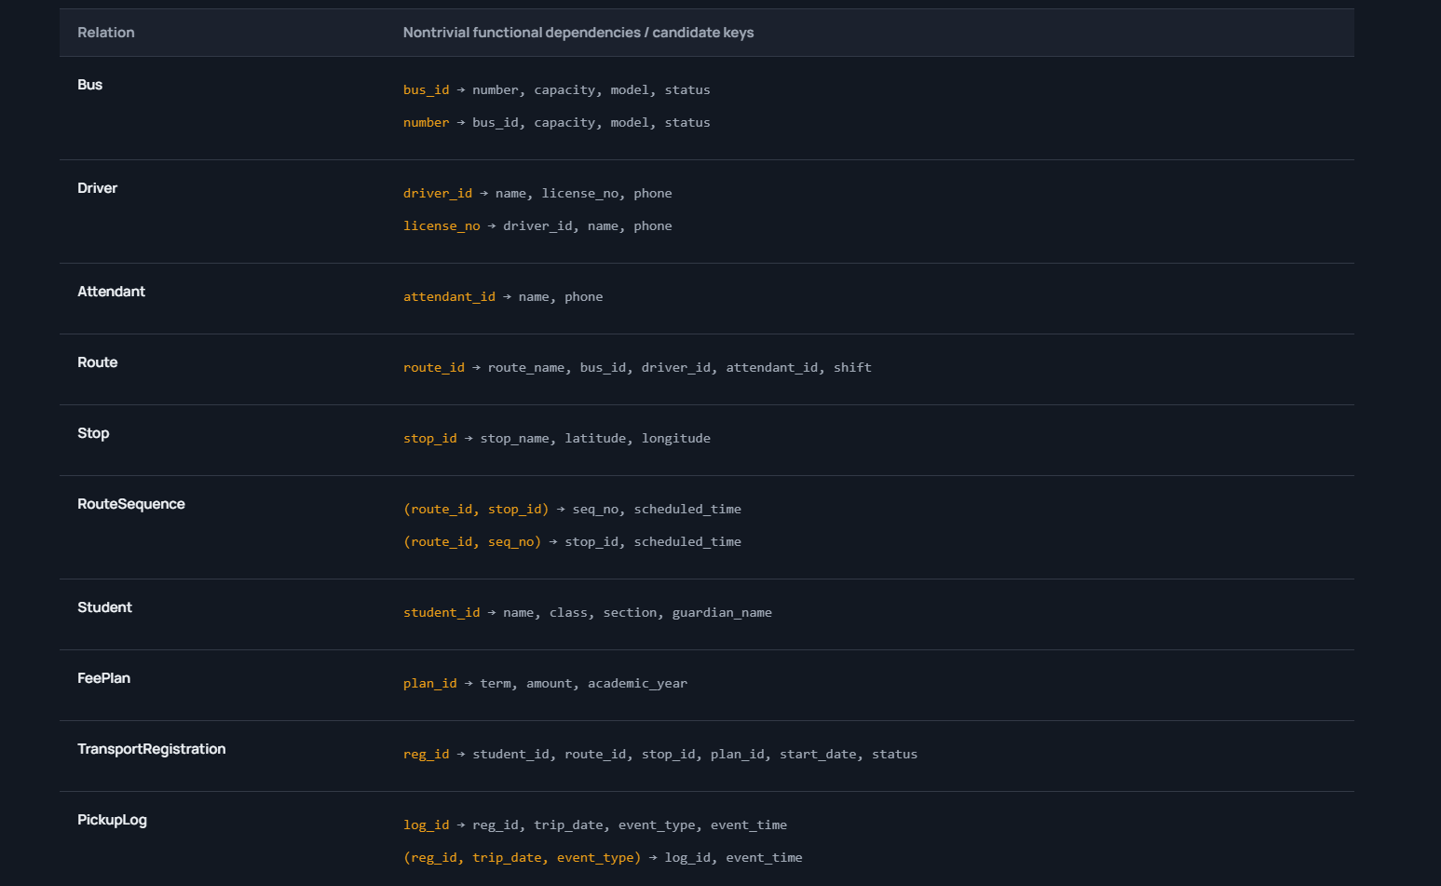
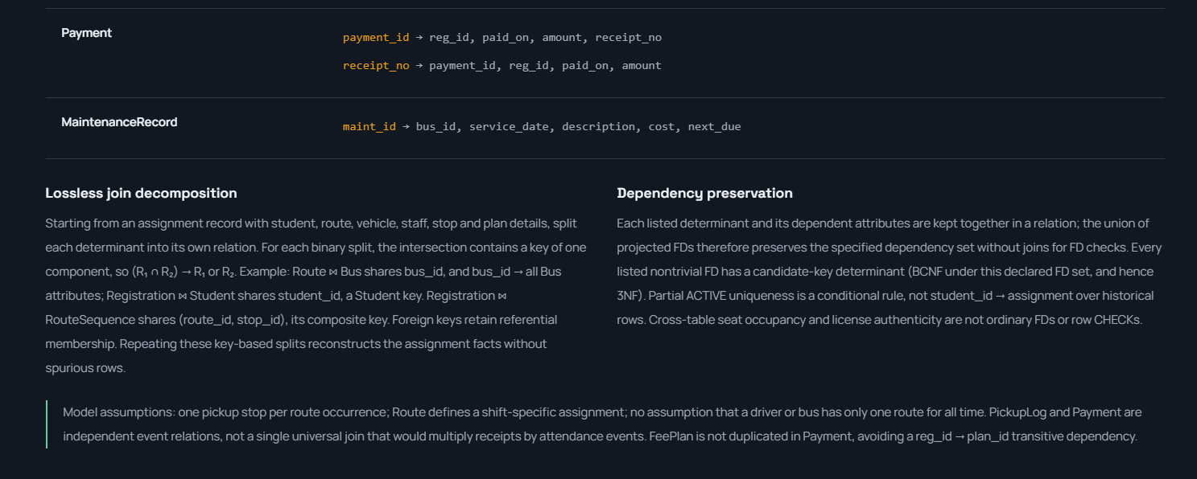
Functional dependencies
Dependencies and candidate keys per relation
Lossless join and dependency preservation notes

Slide 16
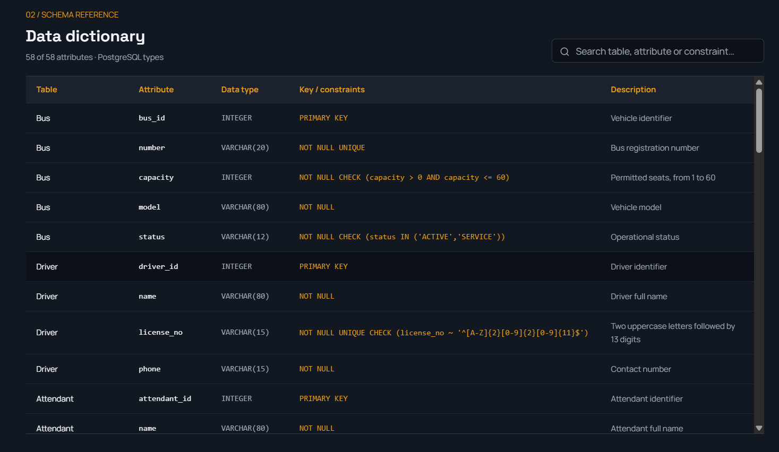
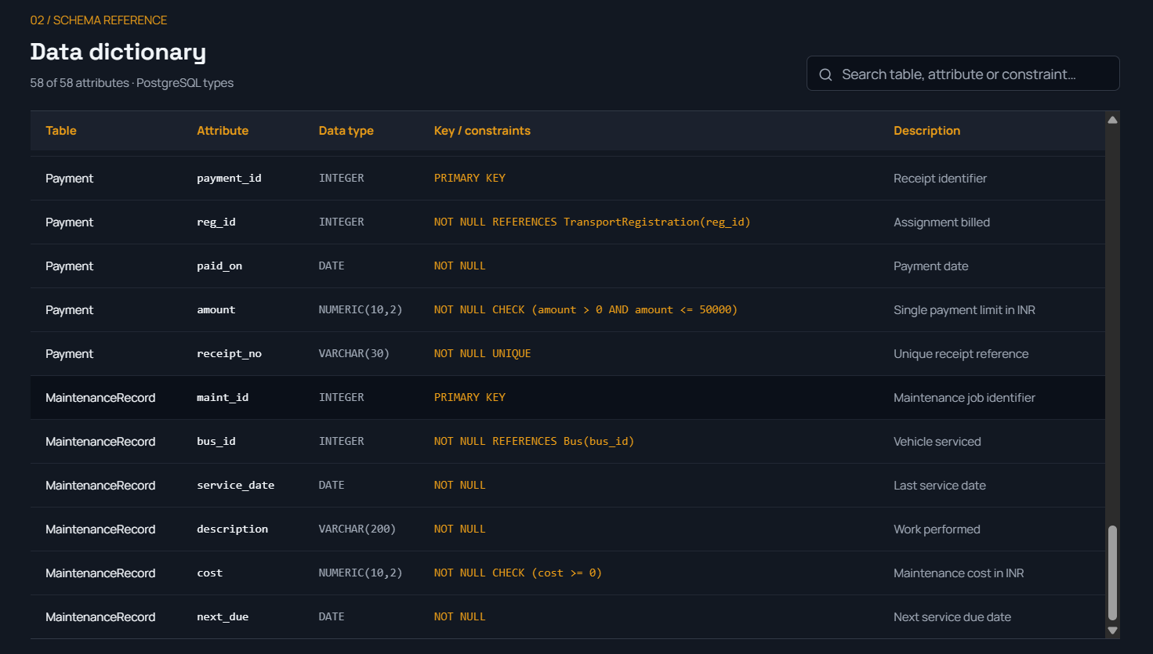
Data dictionary
Searchable dictionary covering all 58 attributes
Types, keys and constraints through MaintenanceRecord

Slide 17
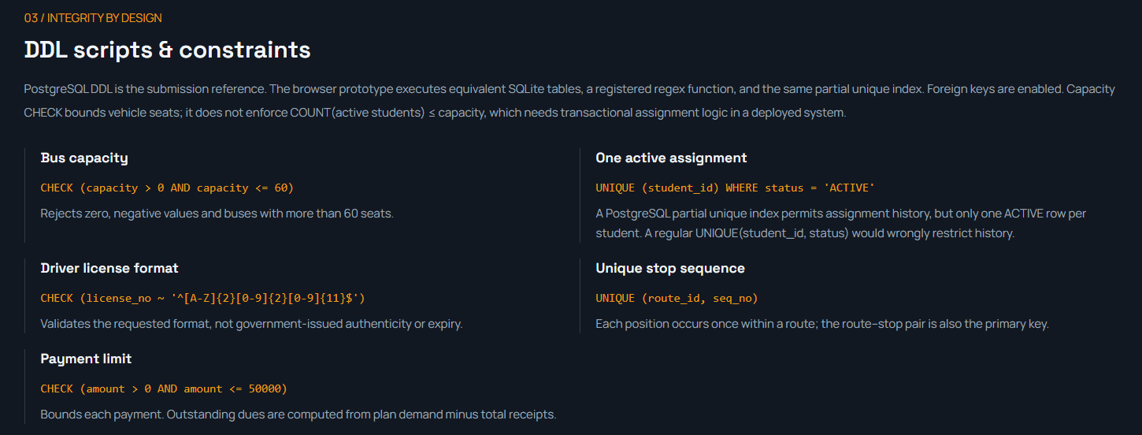
DDL scripts and constraints
Five key integrity rules, each shown with its SQL

Slide 18
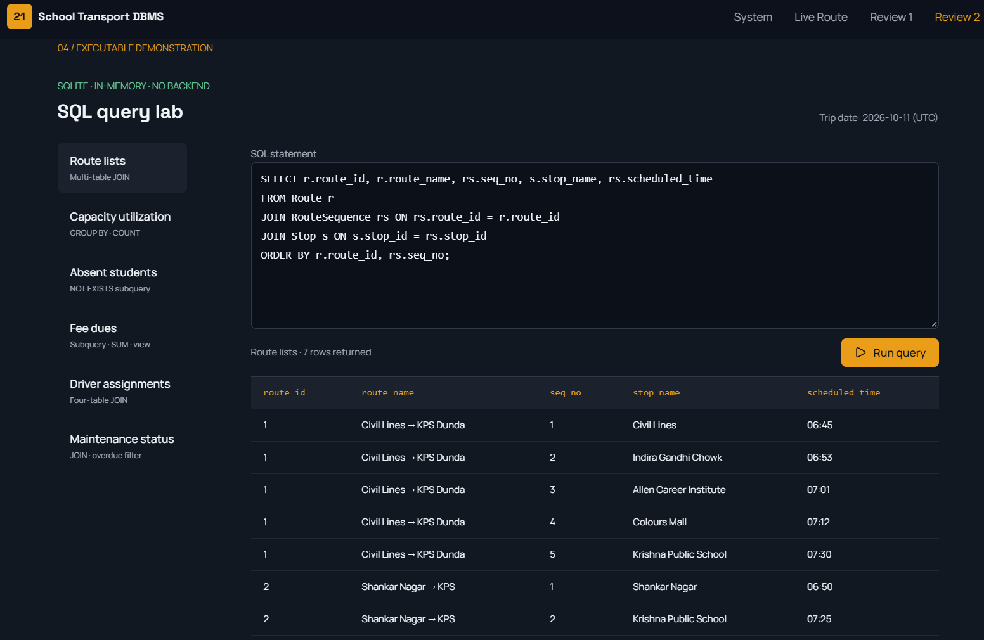
SQL query lab
Run the report queries in the browser against the sample data

Slide 19
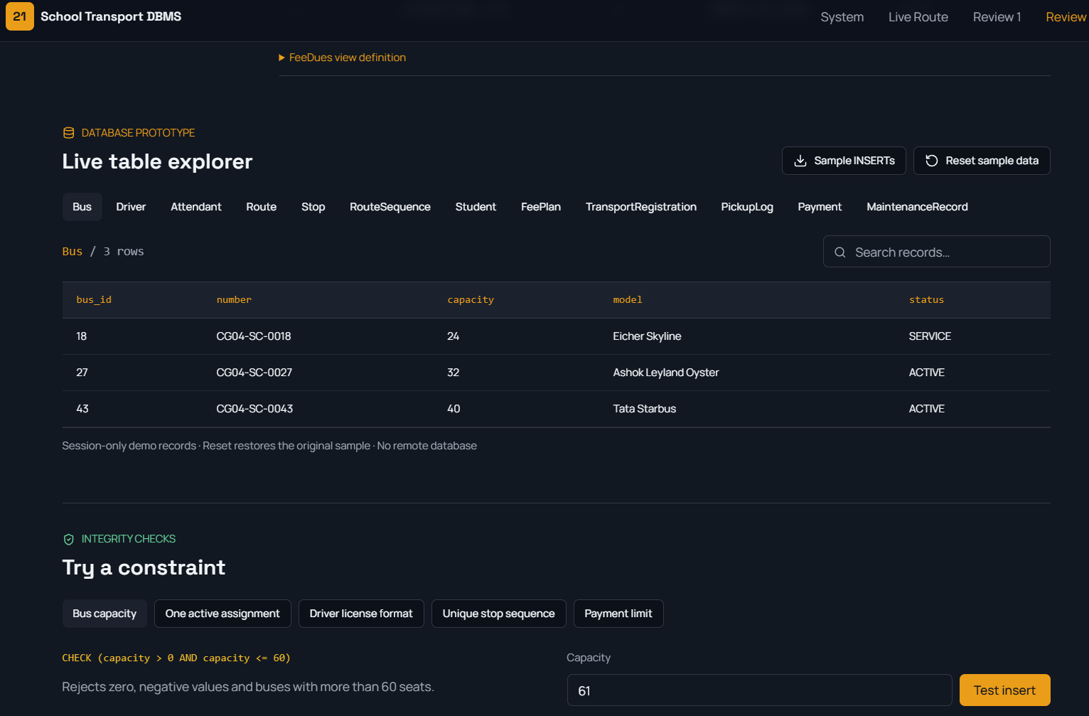
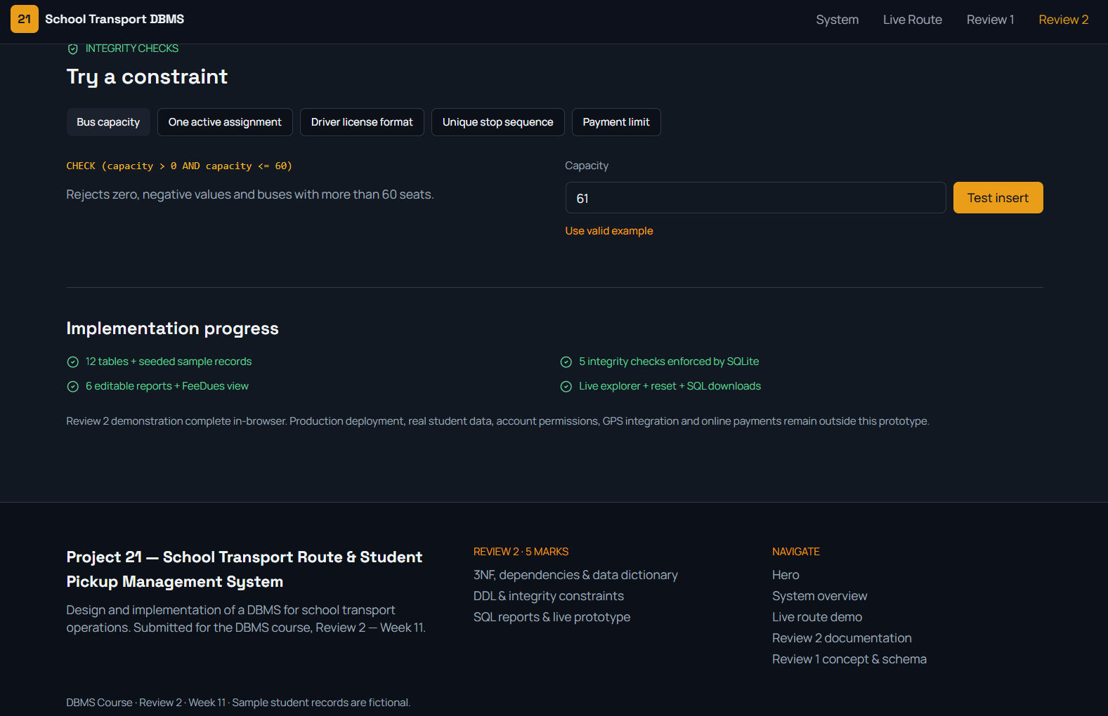
Database prototype
Live table explorer for all 12 tables
Try a constraint: test inserts against the integrity rules

Slide 20
Design takeaways
1
Focused tables
2
Safe registrations
12 tables linked by 11 foreign keys keep fleet, routes, students and fees separate.
A composite key ties each student to a stop that really exists on the route.
3
Rules in the database
4
Full history
12 CHECKs, 5 UNIQUE constraints and a partial index guard the data.
Pickups, payments and maintenance are all recorded for reporting.

